Slide 1
Week 3: Empathize Problems
Warm Up Question: Favorite way to relax after a long day?
Start *before* class starts!
Remember, use this time to get to know the students around you. How many different suggestions can you recall?

Slide 2

Physics Girl – On Computer Science!

Slide 3
Computer Science is..
Solving Problems!
and Solving Puzzles – using both creative and logical side of the brains
Taking problems
Breaking into smaller problems (divide)
Solving them (conquer)
Putting them together to solve larger problems (glue)
Last weeks ”homework”
What are problems/opportunities you see around you?
Stuff that could be better, stuff that technology can improve.
Did you do it?
If not, think of a few things real quick.

Slide 4
Activity – Empathize
With a partner(s) – Discuss your ideas!
Narrow down to 2 – 3 ideas – where software/applications can be a solution
try to answer the following:
What is the problem / opportunity?
Who are the major stake holders?
Audience(s)
Groups needed to be involved?
How can technology be a means of solving it?
What you are working on
Defining the requirements for an application.
In two weeks, you should pick 1 (one) idea, and try to have it clearly defined.
Partners :
Our goal is to encourage and question.
Not the idea, but brainstorm audiences, groups.
Focus on asking open ended questions, not suggestions or solutions!

Slide 5
Methods to our Madness

Slide 6
Changing Gears to Code
Divide-Conquer-Glue
Solving problems, takes looking at them different
Take a problem, break it into smaller parts.
Methods
Methods are meant to focus on
ONE idea, one task, one thing!
Methods ideally return a value (but not always)
This value is used throughout your code
How to know when to write methods?
If you “cut and paste” code, you should probably be using methods
When you are dealing with a single task, you should probably be using a method
When you have more than 20 lines of code – you are probably doing it wrong and need some methods.

Slide 7
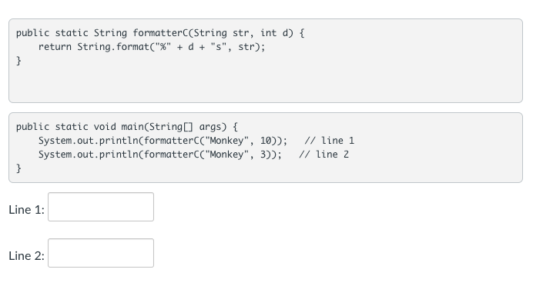
Knowledge Check: Discuss
Going Further – What if we passed in “Monkey”, -10
Notes:
TA – you may want to demonstrate this one with code.

Slide 8
Designing and Testing Methods
Designing Methods
Pre-condition – what can you assume going into the method
Post-condition – what will the method produce
your return type
When Coding Methods
Focus on the one task (biggest mistake is looking at the entire program)
TEST every method, before coding other methods!
This is called “unit testing” and a major component of Test-Driven Development (TDD)
Testing helps define specifications
Hard to do, as feels like writing twice, but changes how you look at the problem
Future classes will give you tools to help with this (jUnit), but for now, we will write every test as another method.
Once a method is written and tested, you can move onto your next task!
Makes a better product!
Let’s look at code

